Slide 1
Ashutosh J.
Lead Vocalist & Guitarist
IT Support Specialist
Health Insurance Support System
A Smart Health Insurance recommended for your precious life.

Slide 2
Some Facts related to Health Insurance in United States of America
The American health care system is unique because US is the only industrialized nation without universal health care coverage.
US spends around 17.9% of GDP or $11,172 per person on health care expenditures.
Americans shop for health insurance as they shop for anything else.
Around 156 million are insured through their work as employer provided private insurance and 120 millions are insured as medicares.

Slide 3
Some Facts related to Health Insurance in United States of America (Cont.)
According to CNBC, Medical bills are the leading cause of bankruptcy in the US.
Around 650,000 people go bankrupt every year beacuse of medical bills.
Medical bills cause a bankruptcy in America every 30 seconds.

Slide 4


Sickness or Accidents can lead to astronomical bills.
Should'nt the developed nation have safety nets ?

Slide 5
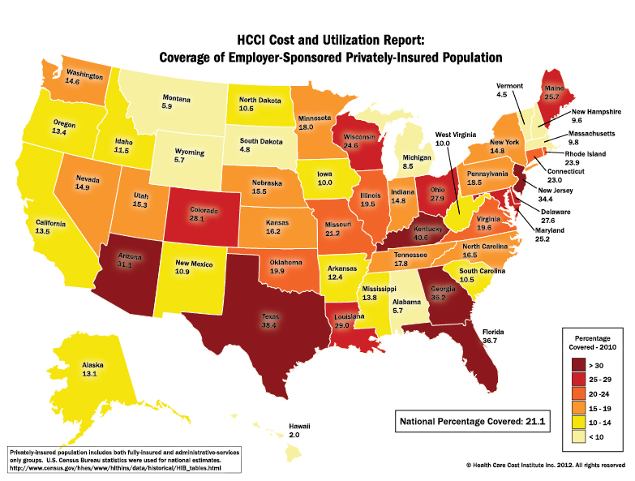
Very low percentage of population is insured by employers, as such it becomes extremely necessary to be careful while selecting insurance which can provide maximum benefits at a given expenditure.

Slide 6

Problem Statement
Despite the fact that the US spends $11,172 per person on health care expenditures and more than 250 million Americans have health insurance then too most Americans go bankrupt because of inefficiency to pay medical expenses.
The main reason behind this issue is that most health insurance doesn't cover additional prominent diseases that occur in a particular area or county They are inefficient in predicting health expenditures. Also, they are inefficient in recommending proper health procedures, hospitals and a suitable health insurance.

Slide 7
Solution
The Health Insurance Support System helps people make smart choice while selecting health insurance which helps people ensure that their insurance covers most prominent diseases and procedures prevalent in their area
This system is that by manipulating data and using regression algorithms, the program can provide crucial details to its users regarding most common disease, checkups, immunizations and procedures taking place in their area so that they can ensure that their insurance covers all of them thus avoiding the hassle of insurance coverage in future. It also helps them in case of buying single disease insurance plans based on prevalent treatment and most popular care plans in the area.
Apart from this, this program also helps them in giving a brief prediction about their coverage amount and healthcare expenses based on regression algorithm.

Slide 8
Tech Stack of Solution
This solution is based on Python and utilises various framworks and libraries from python for data manipulation, Machine Learning and deployment.
Insurance Support:
The program manipulates the datasets provided using pandas in the form where the data provided can be used to provide useful insights for the people. Libraries used: Pandas, Numpy
Machine Learning:
The program used Random Forest regression as it provided least error out of all regression algorithms. Other candidates were Simple Linear and Polynomial. Metric used was Root Mean Squared Error (RMSE). Data preprocessing techniques used were – One Hot Encoding, Label Encoding, Scaling as well as Minimal feature engineering. Dataset was divided intro train and test at ratio of 0.2
Deployment:
Program was deployed using Flask in backend and simple HTML/CSS for frontend.

Slide 9
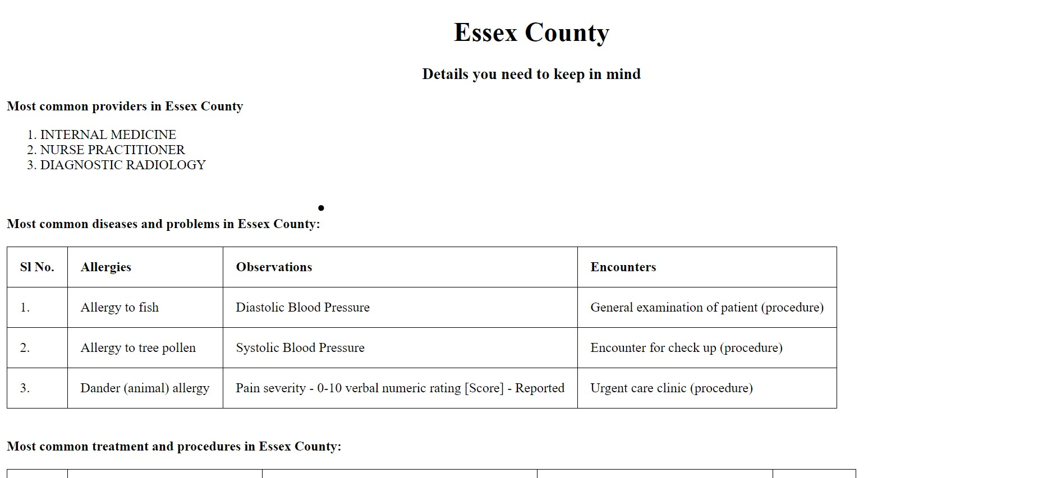
Insurance Support :

Slide 10
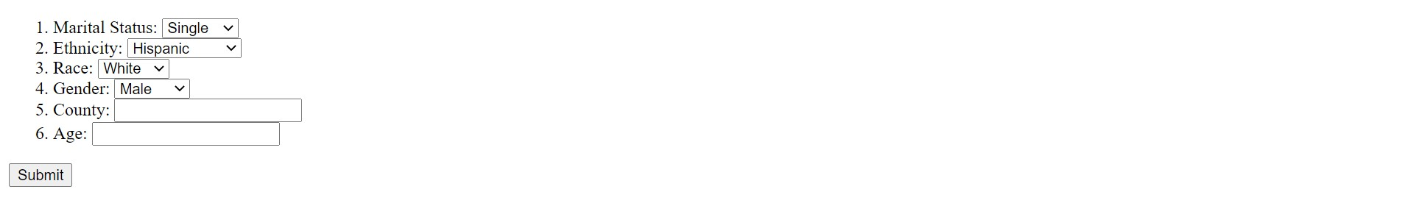
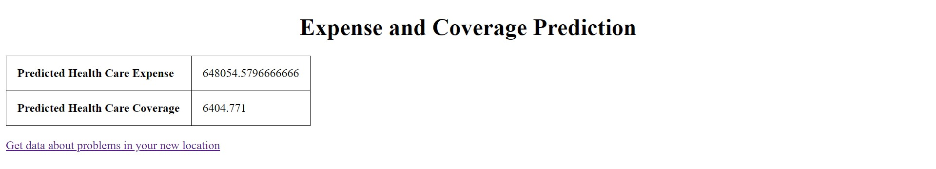
Predicted health care expense and coverage:

